Slide 1
Data
Representation
1

Slide 2
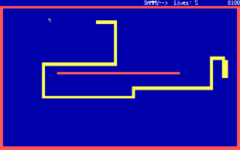
Binary Encoding
i
Bits, Bytes, and Nybbles

Slide 3
Positional number systems
The numbers we use are written positionally: the position of a digit within the number has a meaning.
2 0 0 0
2 x 10³
0 0 0
0 x 10²
2 0 2 1 =
=
2 0
2 x 10¹
+ 1
1 x 10⁰

Slide 4
Positional number systems
The numbers we use are written positionally: the position of a digit within the number has a meaning.
Most Significant
2 0 2 1
Least Significant
1000s
100s
10s
1s
10³
10²
10¹
10⁰
How many (digits) symbols do we have in our number system?
  10: 0, 1, 2, 3, 4, 5 ,6 ,7, 8, 9

Slide 5
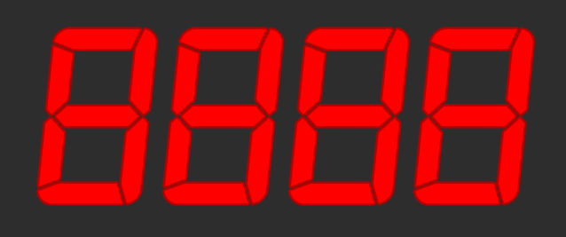
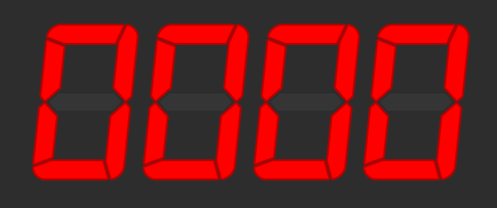
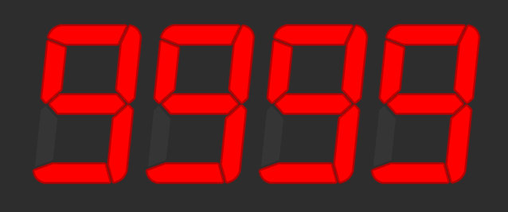
Range of numbers
Suppose we have a 4-digit numeric display.
What is the smallest number it can show?
What is the biggest number it can show?
How many different numbers can it show?
  9999 - 0 + 1 = 10,000
  What power of 10 is 10,000?
    10⁴
Notes:
How do you calculate the number of elements in a range? max-min+1

Slide 6
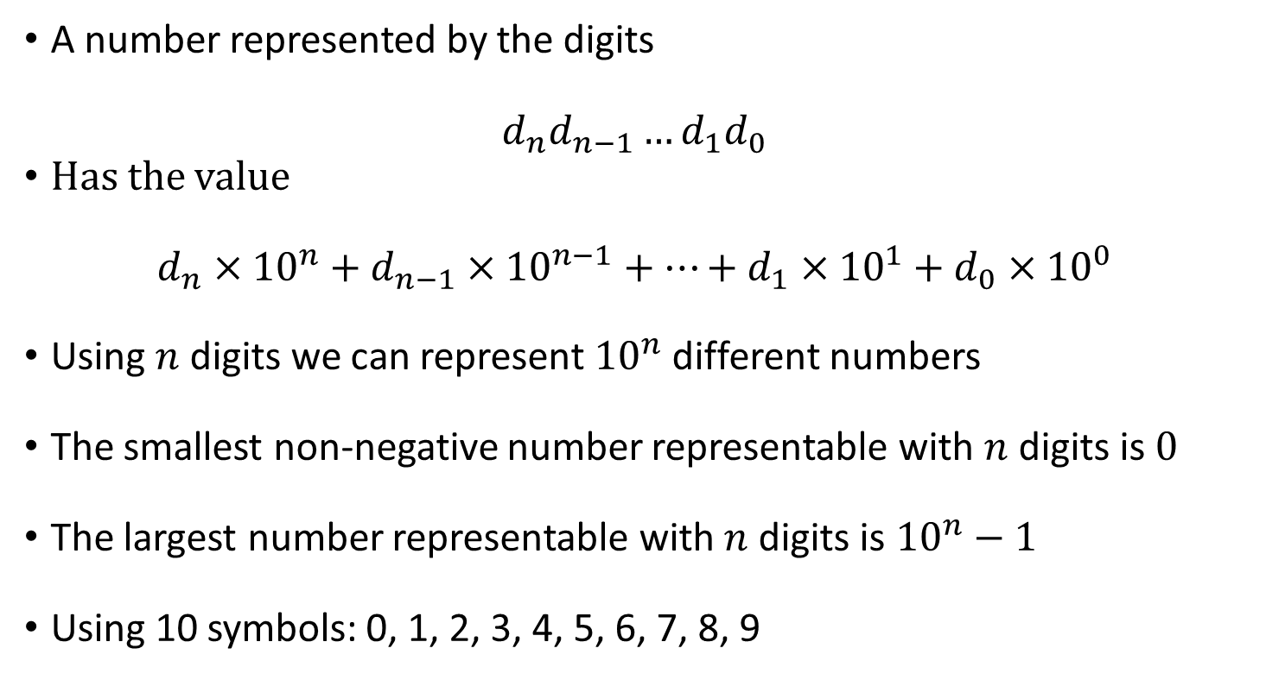
So… with the numbers we use every day…
A number represented by the digits
$d_{n}d_{n−1}…d_{1}d_{0}$
Has the value
$d_{n}×{10}^{n}+d_{n−1}×{10}^{n−1}+…+d_{1}×{10}^{1}+d_{0}×{10}^{0}$
Using $n$ digits we can represent ${10}^{n}$ different numbers
The smallest non-negative number representable with $n$ digits is $0$
The largest number representable with $n$ digits is ${10}^{n}−1$
Using 10 symbols: 0, 1, 2, 3, 4, 5, 6, 7, 8, 9

Slide 7
Numeric Bases
These 10s keep popping up… and for good reason
We use a base-10 (decimal) numbering system
  10 different symbols, and each place is a power of 10
But we can use (almost) any number as a base!
The most common bases when dealing with computers are base-2 (binary), base-16 (hexadecimal), and (rarely) base-8 (octal)
When dealing with multiple bases, you can write the base as a subscript to be explicit about it:
5₁₀ = 101₂

Slide 8
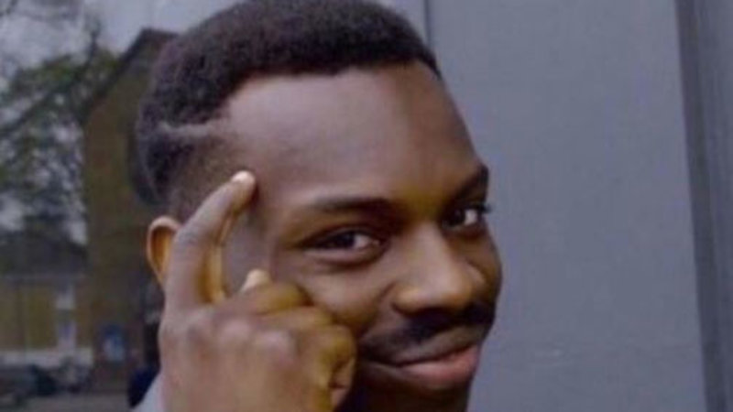
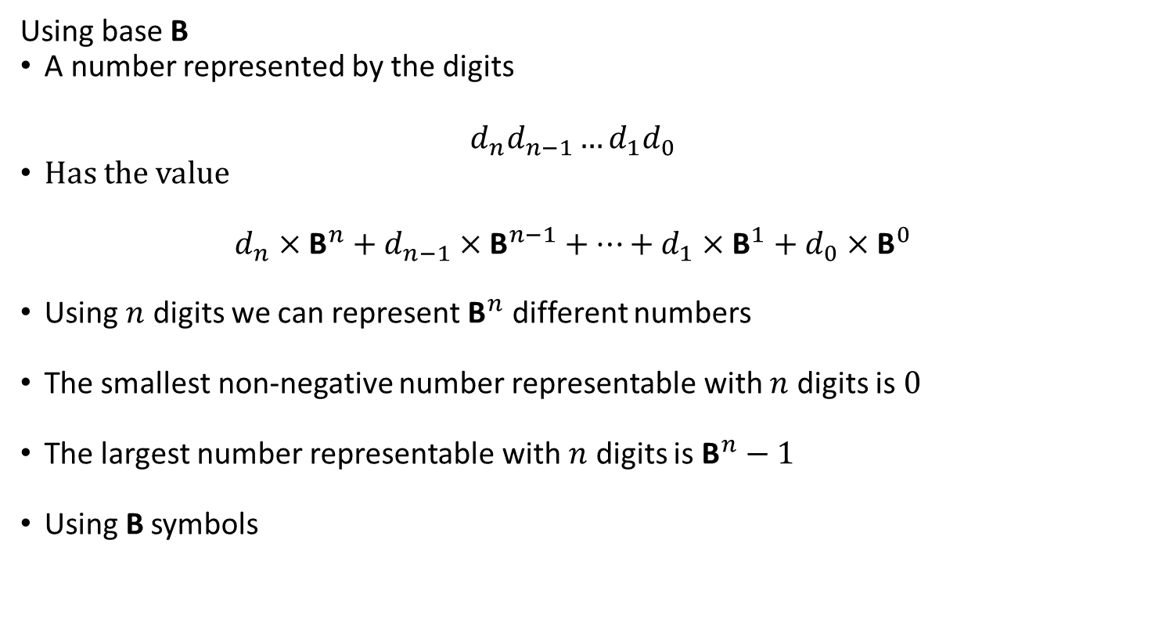
Making a number system
Using base B
A number represented by the digits
$d_{n}d_{n−1}…d_{1}d_{0}$
Has the value
$d_{n}×{\text{B}}^{n}+d_{n−1}×{\text{B}}^{n−1}+…+d_{1}×{\text{B}}^{1}+d_{0}×{\text{B}}^{0}$
Using $n$ digits we can represent ${\text{B}}^{n}$ different numbers
The smallest non-negative number representable with $n$ digits is $0$
The largest number representable with $n$ digits is ${\text{B}}^{n}−1$
Using B symbols
If you use base 0 you don’t need to remember any symbols

Slide 9
Binary – Base 2

Slide 10
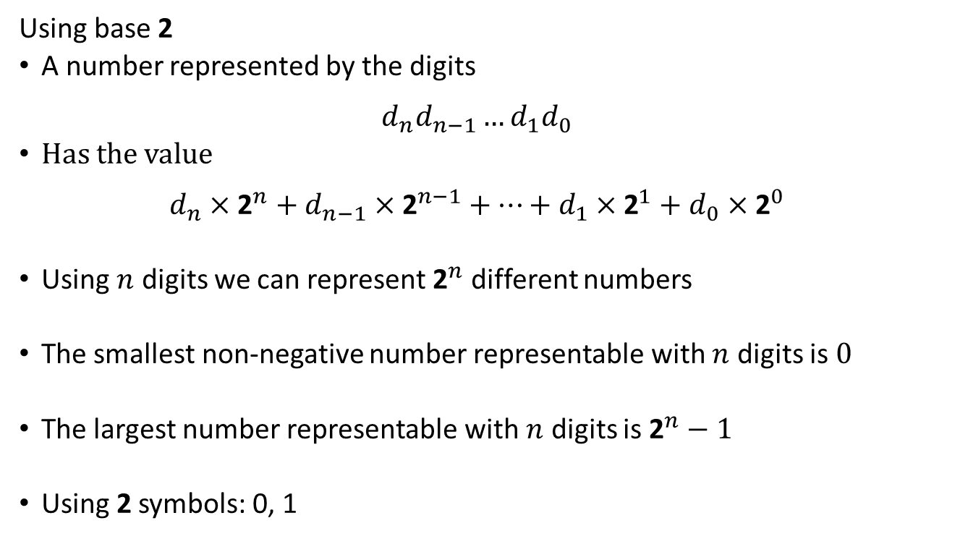
Let's make a base-2 number system
Using base 2
A number represented by the digits
$d_{n}d_{n−1}…d_{1}d_{0}$
Has the value
$d_{n}×{\text{2}}^{n}+d_{n−1}×{\text{2}}^{n−1}+…+d_{1}×{\text{2}}^{1}+d_{0}×{\text{2}}^{0}$
Using $n$ digits we can represent ${\text{2}}^{n}$ different numbers
The smallest non-negative number representable with $n$ digits is $0$
The largest number representable with $n$ digits is ${\text{2}}^{n}−1$
Using 2 symbols: 0, 1
Notes:
2 bits -> 0-3
3 bits -> 0-7
4 bits -> 0-15
5 bits -> 0-31
6 bits -> 0-63
7 bits -> 0-127
8 bits -> 0-255
10 bits -> 0-1023
16 bits -> 0-65535
32 bits -> 4 Gi

Slide 11
Binary (base-2)
We call a Binary digIT a bit – a single 1 or 0
When we say an n-bit number, we mean one with n binary digits
1 × 128 +
0 × 64 +
0 × 32 +
1 × 16 +
0 × 8 +
1 × 4 +
1 × 2 +
0 × 1
= 150₁₀
MSB LSB
1001 0110
=
2⁷ 2⁶ 2⁵ 2⁴ 2³ 2² 2¹ 2⁰
128s 64s 32s 16s 8s 4s 2s 1s
To convert binary to decimal: ignore 0s, add up place values wherever you see a 1.
It’s the only odd number!

Slide 12
Converting the other way around
Ok! then. Let’s go back to decimal for a bit
2 0 2 1
How would you extract this number???
How I like to think of it:
When you divide by the BASE you are moving the decimal point in that BASE
2
R 0
10
2 0
R 2
Just divide by 10!
10
2 0 2
R 1
10
2 0 21

Slide 13
What happens when you divide by 10?
Turns out that dividing by 10 in any base has the same outcome
0b10
2₁₀
1
R 1
2₁₀
3
R 0
2₁₀
6
R 0
2₁₀
12
R 1
11001₂
2₁₀
25

Slide 14
Bits, bytes, nibbles, and words
A bit is one binary digit, and its unit is lowercase b.
A byte is an 8-bit value, and its unit is UPPERCASE B.
  This is (partially) why your 30 megabit (Mbps) internet connection can only give you at most 3.57 megabytes (MB) per second!
A nibble (also nybble) is 4 bits
  Corresponds nicely to a single hex digit.
A word is the "most comfortable size" of number for a CPU.
When we say "32-bit CPU," we mean its word size is 32 bits.
  This means it can, for example, add two 32-bit numbers at once.
BUT WATCH OUT:
  Some things (Windows, x86) use word to mean 16 bits and double word (or dword) to mean 32 bits.
– half of a byte

Slide 15
Why binary? Whynary?
Why indeed?
What color is this?
0 | 1 | 2 | 3 | 4 | 5 | 6 | 7 | 8 | 9

Slide 16
Why binary? Whynary?
Why indeed?
What color is this?
0 | 1

Slide 17
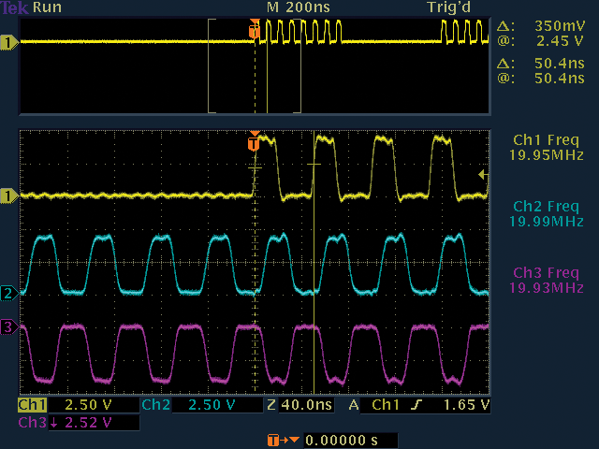
Binary Representation
Computers translate electrical signals to either 0 or 1.
It is relatively easy to devise electronics that operate this way.
In reality, there is no such thing as “binary” so we often have to approximate and mitigate error.
Oscilloscope visualization of several digital wires. From @computerfact on Twitter.

Slide 18
Everything in a computer is a number
So, everything on a computer is represented in binary.
  everything.
    01100101 01110110 01100101 01110010 01111001 01110100 01101000 01101001 01101110 01100111 00001010 00000000
Java strings are encoded using UTF-16
  Most letters and numbers in the English alphabet are < 128.
  “Strings are numbers”
    83 116 114 105 110 103 115 32 97 114 101 32 110 117 109 98 101 114 115 0
ASCII is also pretty common (the best kind of common)
  That’s what we will be using → 8 bit numbers represent characters
  Letters and numbers (and most/all ascii characters) have the same value as UTF-16
Do try this at home: what does this mean?
71 111 111 100 32 74 111 98 0

Slide 19
Hexadecimal – Base 16
The binary shorthand

Slide 20
Hexadecimal
Binary numbers can get really long, quickly.
  3,927,664₁₀ = 11 1011 1110 1110 0111 0000₂
But nice "round" numbers in binary look arbitrary in decimal.
  1000000000000000₂ = 32,768₁₀
This is because 10 is not a power of 2!
We could use base-4, base-8,
base-16, base-32, etc.
  Base-4 is not much denser than binary
    e.g. 3,927,664₁₀ = 120 3331 2323 0000₄
  Base-32 would require 32 digit symbols. Yeesh.
    They do, oddly, have their place… but not really in this context.
  Base-8 and base-16 look promising!
Decimal
Binary
Hex
0
0
0000
1
1
0001
2
2
0010
3
3
0011
4
4
0100
5
5
0101
6
6
0110
7
7
0111
8
8
1000
9
9
1001
A
10
1010
B
11
1011
C
12
1100
D
13
1101
E
14
1110
F
15
1111

Slide 21
Hexadecimal or “hex” (base-16)
Digit symbols after 9 are A-F, meaning 10-15 respectively.
Usually we call one hexadecimal digit a hex digit. No fancy name :(
0 × 16⁷ +
0 × 16⁶ +
3 × 16⁵ +
11 × 16⁴ +
14 × 16³ +
14 × 16² +
7 × 16¹ +
0 × 16⁰ =
3,927,664₁₀
003B EE70
=
16⁷ 16⁶ 16⁵ 16⁴ 16³ 16² 16¹ 16⁰
To convert hex to decimal: use a dang calculator lol

Slide 22
Binary to Hex (animated)
0100
1100
1010
0010
0000
0010
0110
0001
4
C
A
2
0
2
6
1
0x4CA20261
32-bits! (Not so bad…)
Q: Create a random binary string and practice!

Slide 23
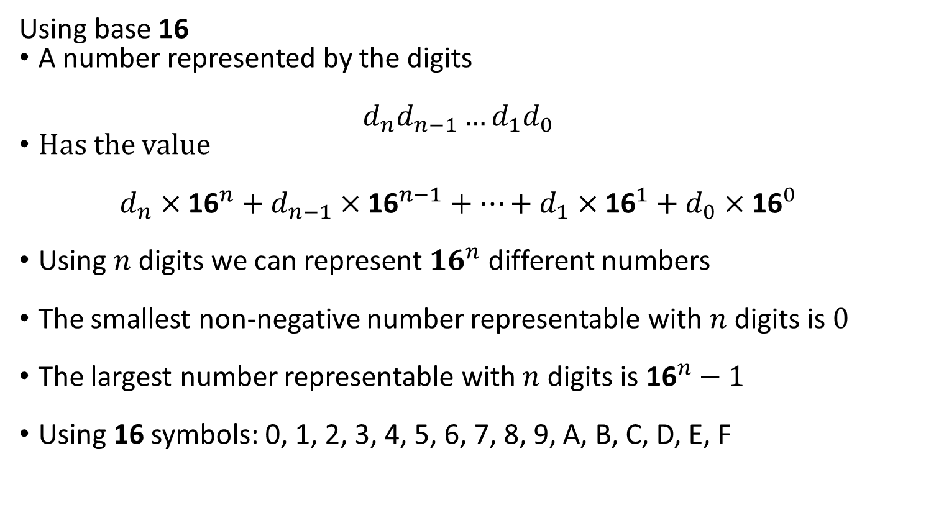
Let's make a base-16 number system
Using base 16
A number represented by the digits
$d_{n}d_{n−1}…d_{1}d_{0}$
Has the value
$d_{n}×{\text{16}}^{n}+d_{n−1}×{\text{16}}^{n−1}+…+d_{1}×{\text{16}}^{1}+d_{0}×{\text{16}}^{0}$
Using $n$ digits we can represent ${16}^{n}$ different numbers
The smallest non-negative number representable with $n$ digits is $0$
The largest number representable with $n$ digits is ${\text{16}}^{n}−1$
Using 16 symbols: 0, 1, 2, 3, 4, 5, 6, 7, 8, 9, A, B, C, D, E, F

Slide 24
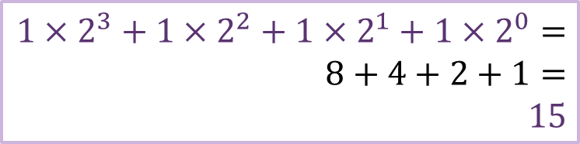


Why?
1111 1111
$$1×2^{7}+1×2^{6}+1×2^{5}+1×2^{4}+1×2^{3}+1×2^{2}+1×2^{1}+1×2^{0}$$
$$1×2^{3}+1×2^{2}+1×2^{1}+1×2^{0}=$$
$$8+4+2+1=$$
$$15$$
$$\left(1×2^{3}+1×2^{2}+1×2^{1}+1×2^{0} \right)×2^{4}+15$$
Factoring
This works with any base that is a power of 2
$$15×{16}^{1}+15×{16}^{0}$$
E.g. Base 4=2²
Split into groups of 2 bits
$$2^{4}=16$$
F
F

Slide 25
Integer Encoding
Casting is Not Just a Witch or Wizard Thing

Slide 26
Finite numbers
In computers, numbers are finite.
Let's say our 4-digit display was counting up:
9997, 9998, 9999…
What comes "next"?
  What does this "0000" really mean?
  It wrapped around.
This is overflow: the number you are trying
to represent is too big to be represented.
Essentially, all arithmetic on the computer is modular arithmetic!
  This causes a lot of software bugs.
  https://en.wikipedia.org/wiki/Pac-Man#Level_256

Slide 27
Number carrousel
Computers perform modulus arithmetic
  Meaning: it goes around!
  E.g. in a 4-bit computer
15
0
1
14
0000
2
1111
0001
13
1110
0010
3
1101
0011
12
4
1100
0100
11
1011
0101
5
1010
0110
6
10
1001
0111
0000
-0001
1111
9
1000
8
7
what is 0 - 1?

Slide 28
What about negative carrousels?
How much is 0 – 1?
  -1
-1
0
1
-2
0000
2
1111
0001
-3
1110
0010
3
1101
0011
-4
4
1100
0100
-5
1011
0101
5
1010
0110
-6
1001
0111
6
-7
1000
-8
7
Why did we stop here?

Slide 29
Signed Numbers (2’s Complement)
Representing negative numbers.
  But it’s a little strange!
Hmm, it’s a little lopsided: -4 doesn’t have a valid positive number.
I can tell it’s negative if it starts with a 1 ☺
  And if it’s positive, then I can clearly see how much it’s worth!
But how exactly… can we tell the value of a negative number?
  We need to negate (flip the sign) negative numbers
    But HOW????
100
110
000
010
101
111
001
011
-4
-3
-2
-1
0
+1
+2
+3
2’s Complement

Slide 30
Two’s complement arithmetic
Negation
You don’t need to subtract!!
  flip(k)+1 == flip(k-1)
    If you ignore the carry! ☺
-(3)
0011
1100
1101
bit pattern for positive 3?
flip!
Add 1!
-(-3)
1101
0010
0011
bit pattern for negative 3?
flip!
Add 1!

Slide 31
Two's complement addition
the great thing is: you can add numbers of either sign without having to do anything special!
Ignore the carry
bit pattern for
-7… positive 7?
to binary?
0111
0011
3
+ 7
10
0011
3
+-7
-4
0111
0011
-
4
+0111
+1001
flip!
+1
1010
1000
1100
to decimal?
0100
this is negative, so what is it? flip!
+1
0011
the actual patterns of bits are the same.
so how does the computer "know" whether it's
doing signed or unsigned addition?
Notes:
Do example in board

Slide 32
Signed Numbers (2’s Complement)
Let’s look some examples:
If the MSB is 1: Flip! Add one!
Otherwise: Do nothing! It’s the same!
11010100➔
-(00101011+1)➔-(43+1)=-44
00100110 =
00100110 = 38
00000000 =
00000000= 0
11111111=
-00000000=-(0+1) =-1

Slide 33
Signed Numbers (2’s Complement)
What happens when we add zeros to a positive number:
What happens when we add ones to a negative number:
10100110 = ?
00100110 = 38
-(01011001+1) = ?
0000000000100110 = ?
38
-01011010 = ?
-90
10100110 = ?
-90
Dang that’s cool!
11111111110100110 =
-00000000001011001 = ?
-90

Slide 34
Can I Get an Extension?
Sometimes you need to widen a number with fewer bits to more
zero extension is easy: put 0s at the beginning.
1001₂ ➔ to 8 bits ➔ 0000 1001₂
But there are also signed numbers… what about those?
  The top bit (MSB) of signed numbers determines the sign (+/-)
sign extension puts copies of the sign bit at the beginning
1001₂ ➔ to 8 bits ➔ 1111 1001₂
0010₂ ➔ to 8 bits ➔ 0000 0010₂
Q: What happens when you sign extend the largest unsigned value?

Slide 35

Absolutely Bonkers
public class AbsTest {
public static int abs(int x) {
if (x < 0) {
x = -x;
}
return x;
}
public static void main(String[] args) {
System.out.println(
String.format("|%d| = %d", Integer.MIN_VALUE, AbsTest.abs(Integer.MIN_VALUE))
);
}
} // Outputs: |-2147483648| = -2147483648
Q: How many bits is a Java int? What happened here?

Slide 36
Integer Ranges
Recall:
  The range of an unsigned integer is 0 to 2^{n} – 1
  Q: Why do we subtract 1?
What is the range of a 2’s complement number?
  Consider the sign bit, how many negative integers?
  Consider, now, the positive integers.
  Remember 0.
-2^{n-1} to 2^{n-1} – 1
Q: What if you needed a range with far more negatives than positives?

Slide 37
Integers in Java C
C allows for variables to be declared as either signed or unsigned.
  Remember: “signed” does not mean “negative” just that it can be negative.
An unsigned integer variable has a range from 0 to 2^{n} – 1
And signed integers are usually 2’s complement: 2^{n-1} to 2^{n-1} – 1
  Where “n” is determined by the variable’s size in bits.
Integer Types: (signed by default, their sizes are arbitrary!!)
  char unsigned char 8 bits (byte)
  short int unsigned short int 16 bits (half-word)
  int unsigned int 32 bits (word)
  long int unsigned long int 64 bits (double-word)
Usually no strong reason to use anything other than (un)signed int.
Q: What is the range of a signed char?

Slide 38
Integers in C: Limits
Since sizes of integers are technically arbitrary…
  They are usually based on the underlying architecture.
… C provides standard library constants defining the ranges.
  https://pubs.opengroup.org/onlinepubs/009695399/basedefs/limits.h.html
#include <limits.h> // Provides INT_MAX etc
#include <stdio.h> // Provides printf
int main() {
printf("%d ", INT_MAX); // Print the maximum signed int
printf("%u\n", UINT_MAX); // Print the maximum unsigned int
return 0;
} // Output: 2147483647 4294967295
Q: Experiment with using "%d" for both. What is the result?

Slide 39
Casting
C lets you move a value from an unsigned integer variable to a signed integer variable. (and vice versa)
However, this is not always valid! Yet, it will do it anyway.
  The binary value is the same, its interpretation is not!
    This is called coercion, and this is a relatively simple case of it.
  Since it ignores obvious invalid operations this is sometimes referred to as “weak” typing.
  The strong/weak terminology has had very fragile definitions over the years and are arguably useless in our context. Let’s ignore them.
Moving values between different types is called casting
  Which sounds magical and it sometimes is.
Q: What is true of the result of casting the value -1 to an unsigned type?

Slide 40
Fractional Binary

Slide 41
Fractional numbers
Up to this point we have been working with integer numbers.
  Unsigned and signed!
However, Real world numbers are… Real numbers. Like so:
That create new challenges!
  Let’s start by taking a look at them.
2 0 1 9
2 0 1 9.320

Slide 42
Just a fraction of a number
The numbers we use are written positionally: the position of a digit within the number has a meaning.
What about when the numbers go over the decimal point?
?
?
?
2 0 1 9
. 3 2 0
1000s
100s
10s
1s
10ths
100ths
1000ths
10³
10²
10¹
10⁰
10⁻¹
10⁻²
10⁻³

Slide 43
A fraction of a bit?
Binary is the same!
Just replace 10s with 2s.
0 1 1 0
.1 1 0 1
2³ 2² 2¹ 2⁰
2⁻¹ 2⁻² 2⁻³ 2⁻⁴
8s 4s 2s 1s
2ths? 4ths 8ths 16ths

Slide 44
To convert into decimal, just add stuff
0 1 1 0
.1 1 0 1
=
2³ 2² 2¹ 2⁰
2⁻¹ 2-² 2⁻³ 2⁻⁴
0 × 8 +
1 × 4 +
1 × 2 +
0 × 1 +
1 × .5 +
1 × .25 +
0 × .125 +
1 × .0625
= 6.8125₁₀

Slide 45
From decimal to binary? Tricky?
0.8125₁₀
x 2
1.6250
6.8125 ₁₀
6÷2₁₀ = 3R0
MSB
0.6250₁₀
x 2
1.2500
3÷2₁₀ = 1R1
0.2500₁₀
x 2
0.5000
1
1
0
.
1
1
0
1
0.5000₁₀
x 2
1.0000
LSB

Slide 46
So, it’s easy right? Well…
What about: 0.1 ₁₀
0.1₁₀
x 2
0.2
0.2₁₀
x 2
0.4
0.4₁₀
x 2
0.8
0
.
0
0
0
1
0.8₁₀
x 2
1.6

Slide 47
So, it’s easy right? Well……
What about: 0.1 ₁₀
0.6₁₀
x 2
1.2
0.1₁₀
x 2
0.2
0
.
0
0
0
1
0.2₁₀
x 2
0.4
0.2₁₀
x 2
0.4
0.4₁₀
x 2
0.8
0.4₁₀
x 2
0.8
1
0
0
1
0.8₁₀
x 2
1.6
0.8₁₀
x 2
1.6

Slide 48
So, it’s easy right? Well………
What about: 0.1 ₁₀
0.6₁₀
x 2
1.2
0.6₁₀
x 2
1.2
0.1₁₀
x 2
0.2
0
.
0
0
0
1
0.2₁₀
x 2
0.4
0.2₁₀
x 2
0.4
0.2₁₀
x 2
0.4
1
0
0
1
0.4₁₀
x 2
0.8
0.4₁₀
x 2
0.8
0.4₁₀
x 2
0.8
1
0
0
1
.
.
.
0.8₁₀
x 2
1.6
0.8₁₀
x 2
1.6
0.8₁₀
x 2
1.6

Slide 49
How much is it worth?
Well, it depends on where you stop!
0.0001 ₂
=
0.0625
0.00011001 ₂
=
0.0976…
0.000110011001 ₂
=
0.0998…

Slide 50
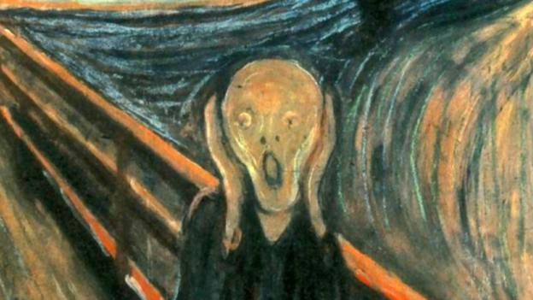
Limited space!
How much should we store?
  We have 32-bit registers, so 32-bits?
    Let’s say we do!
How many bits are used to store the integer part?
How many bits are used to store the fractional part?
What are the tradeoffs?

